Slide 1
Speech introducing a lab
and
Closing speech

Slide 2
Speech introducing a lab

Slide 3
Contents
Elements in a speech introducing a lab
Sample
Expressions used in introducing a lab
Practice

Slide 4
Strategies for introducing a laboratory
1. Laboratories can be introduced in the following aspects
History
Location
Organization
Research
Directors
Achievements
Students may be asked to work in groups to list the points that may be included in the introduction to a lab.

Slide 5
2. If you have no idea about how to introduce your laboratory, the following clues may be helpful.
A general introduction of the lab (big, advanced, world-first-class, newly equipped, spacious and bright, etc.
When was it founded? （Why was it set up?）
Compared with what you have today, what was it like at the very beginning? （size, apparatuses, equipment, functions, etc.）
What kind of experiments can be done here in the lab?
What kind of important/successful/influential experiments have been done here? And who is in charge of them?
Are you satisfied with your lab? Why or why not?

Slide 6
Sample
The State Key Laboratory of Soil and Sustainable Agriculture was established in 2003, as authorized by the Ministry of Science and Technology, on the basis of the former Laboratory of Material Cycling in Pedosphere. Professor Shen Renfang serves as the present director of the laboratory, and Professor Zhou Dongmei and Professor Xu Hua serve as deputy director. Professor Zhou Jianmin heads the Lab’s academic committee. The Lab has a permanent staff of 48 members, among whom 2 academicians of Chinese Academy of Sciences, 26 professors, 4 chief scientists of the “973” project financed by the National Outstanding Young Scientists Grant”, and 6 listed into the CAS’s “Hundred Talent Program”.
The lab’s research is focused on evolution of soil resources and countermeasures for soil degradation under intensive use, soil nutrient supply processes and methodologies for regulation of plant nutrient uptake, pollutant transformation processes in soils and techniques for remediation of polluted soils; and relationships between land use and environmental change; soil biological processes and related applied techniques. The overall objectives of the lab are: to develop modern soil
Establishment of the Lab
Staff members
Research tasks

Slide 7
science with soil quality as its core concept and stimulate the development of relevant subjects to develop a soil information system of China and digitize soil resources management; to develop theoretic and technical system for high-efficient utilization of water and fertilizers, cleaner agriculture production, and remediation of contaminated soils; and to work out a model for harmonized development of agriculture and environment, so as to guarantee food safety of the country, raise soil productivity and improve eco-environmental quality.
Since 2000, the Lab has undertaken and accomplished over 200 major research projects for the state and regions, among which 3 are “973” projects financed by the National Basic Research Program, and 1 is key project of National Natural Science Foundation. Nine awards for science and technology achievements were conferred to the lab in the past 6 years, including 2 second class national awards and 2 first class Jiangsu provincial awards for advancement in science and technology. Moreover, staff members of the Lab have published over 1200 academic papers in Chinese and English, among which more than 400 appeared on SCI journals.
Research objectives
Achievements
Awards

Slide 8
Expressions used in traducing a lab
1. The Multimedia Language Lab (MLL) was installed at the center for English Language and Orientation Programs (CELOP) during the summer of 1996.
2. The Digital Language Lab facilities are located on the second floor of Meyer Library and consist of three instructional areas.
3. The Boston College Language Laboratory is committed to promoting and facilitating the acquisition and enhancement of the language skills and cultural competency by providing the University community with efficient access to an expanding collection of multimedia resources and instructional technology.
4. The primary focus of the laboratory is to make it easier for humans to communicate with complex computers and with each other, and to access the vast amounts of information stored online.
5. Multimedia Information Systems Laboratory conducts research on human-computer interaction.
6. The OSU Foreign Language Lab Center provides learning tools for students enrolled in foreign language courses, such as foreign films, computer software, and listening tapes.

Slide 9
7. Internet and printing access is available at each workstation.
8. The lab boasts a Sony digital audio console with 24 student stations where students can work at their own pace and do a variety of activities without the need for individual audio cassettes.
9. It comprises twenty student positions with full audio and video facilities, controlled by a teacher console.
10. The lab serves as a place where students can come on an individual basis to do their work or as a classroom in which a video may be shown to an entire class.
11. They are multi-computer teaching facilities dedicated to the examination, analysis and production of work in the arts and humanities using emerging computer technologies.
12. This laboratory is used exclusively for teaching purposes by the Language Sections and the English Language Support Program of the Humanities Program.
13. Netscape is also installed especially for intermediate and advanced learners to use as a resource of information.
14. They provide equipment and support for students and faculty using computer workstations to produce graphics, hypertext, video, animation and sound.

Slide 10
Practise your strategy
Work in small groups to discuss how you all understand the laboratory and then fill in the blanks.
A laboratory is a room or a building used for ______________________,
a place of _____________________________________,
a site of _______________________________________,
a base of __________________________________, and
a cradle of _____________________________________.

Slide 11
Closing Speech

Slide 12
Contents
Key elements in a closing speech
Sample
Expressions used in closing speech
Practice

Slide 13
Key elements in a closing speech
Work in groups to list the points that may be included in a closing speech.
Expressing thanks to keynote speakers, participants, moderator(s), organizer(s), and sponsor(s )
Reviewing or summarizing briefly what have been done at the conference
Evaluating the conference properly (achievements, significance, influences)
Announcing the closing of the conference
Extending invitation to the next conference

Slide 14
Sample: closing speech by an organizer
Ladies and gentlemen,
I am now, on behalf of the organizing committee, to give the closing speech.
I believe that our Conference is a great success. It went smoothly as scheduled. In these five days the Conference has covered so many important and complex problems in the field of XYZ both theoretical and practical. All the presentations were very illuminating and informative. And the heated panel discussions were stimulating and fruitful. Now with great joy and a reluctant mind to part, we get together again to declare that the Conference has drawn to a successful close.
It is our hope that the result of the Conference will carry the study of XYZ to a new stage. We all hope to maintain close contact and cooperation with each other in the field of future research work on XYZ.
Purpose of the speech
Review and evaluation
Significance and expectation

Slide 15
As the organizer of the Conference, I would like to express our sincere thanks to the members of the International Committee, the members of the organizing Committee, and the authorities of Nanjing University and Jiangsu Province for all their support and contributions to this successful Conference. Thanks are also extended to all the participants who came from over 30 countries and regions. Thank you for your attention to all our sessions and thank you for your stimulating questions.
Now, the Conference is closed. Let’s meet again in London in 2018.
Thank you.
appreciation
Announcement

Slide 16
Expressions used in closing speech
Summarizing the achievements
We are now very close to the end of this International Conference which has achieved tremendous successes. More than 200 participants have come to Manhattan to discuss not only general questions about XXX but more concrete questions and problems and their possible solutions.
We have worked actively in the workshops these days, and our work has provided value not only to the resolution but also to the work of this Association in general.
I believe that our conference is a great success. It went smoothly as scheduled. In these five days the conference has covered so many important and complex problems in the field of biochemistry, both theoretical and practical. All the presentations were very illuminating and informative. And the heated panel discussions were very stimulating and fruitful.
Our conference has lasted three days. It has achieved tremendous successes. Eighteen scientists and scholars spoke at the conference. Many more aired their views freely at group discussions, which proceeded in a friendly and lively atmosphere. I benefited greatly by attending this conference.
In the past few days you have been addressing themes of paramount importance, and please allow me to express my admiration for and appreciation of your wisdom in these fields, since such wisdom is the basis for action.

Slide 17
Expressing the thanks
I would like to thank various people. First of all, the chairpersons for their efficient ways in which they handled their sessions. Second, the speakers for their excellent presentations. Third, the delegates for having been an excellent audience and having provided stimulating discussions. Last but not least, I would like to thank the companies for the financial support and cooperation we received in organizing and conducting this conference.
On behalf of all the members of our Organizing Committee, I wish to express our sincere gratitude to all of you who have so actively participated in this congress to make it such a success. I now extend best wishes to all of you and I look forward to seeing you again at the next congress two years hence in Beijing.
Let me congratulate you for the achievements of this conference. This was the result of very hard work by delegates under the very competent leadership of the chairman.
Thank SEU for hosting the conference. Thanks go to everybody who has contributed to the conference with reports and introductions. Thanks for the financial contributions to this conference from the city and all other organizations and a number of private sponsors.
As the organizer of the conference, I would like to express our sincere thanks to the members of the Organizing Committee, the authouities of Nanjing University and Jiangsu Province for all their support and contributions to this successful conference. Thanks are also due to all the participants who came from over 30 countries and regions.

Slide 18
Announcing the next conference
It is a privilege for me to announce that the next congress will be held in London in 2014.
I am proud to have the privilege to announce that the next International Conference on Strategies for Enhancing Access to Medicine will be held in China in May 2014. We should of course welcome as many scientists as possible. We look forward to seeing you then.
And lastly, my friends, see you next yeat in Beijing, China for our next conference.
I look forward to seeing you again at the next conference two years hence in Nanjing in 2014. You will be warmly welcome there.
Let us meet again in Paris in 2014 at the next world congress of biomaterials.
Our next conference will be held in New York at our college. We will try our best to make the forthcoming gathering another fruitful and pleasant one.

Slide 19
Announcing the closing of the conference and expressing good wishes
Ladies and gentlemen, you have my best wishes for your still greater achievements in your career. Now, I declare the conference closed.
I hope you will have a safe and peaceful journey home and offer to you my warmest best wishes. I now declare the conference officially closed.With these few remarks,
Now, the conference is closed. Let’s meet again in London in 2014.
I now have the duty and the honor to declare the conference officially closed. Good wishes to all of you.

Slide 20
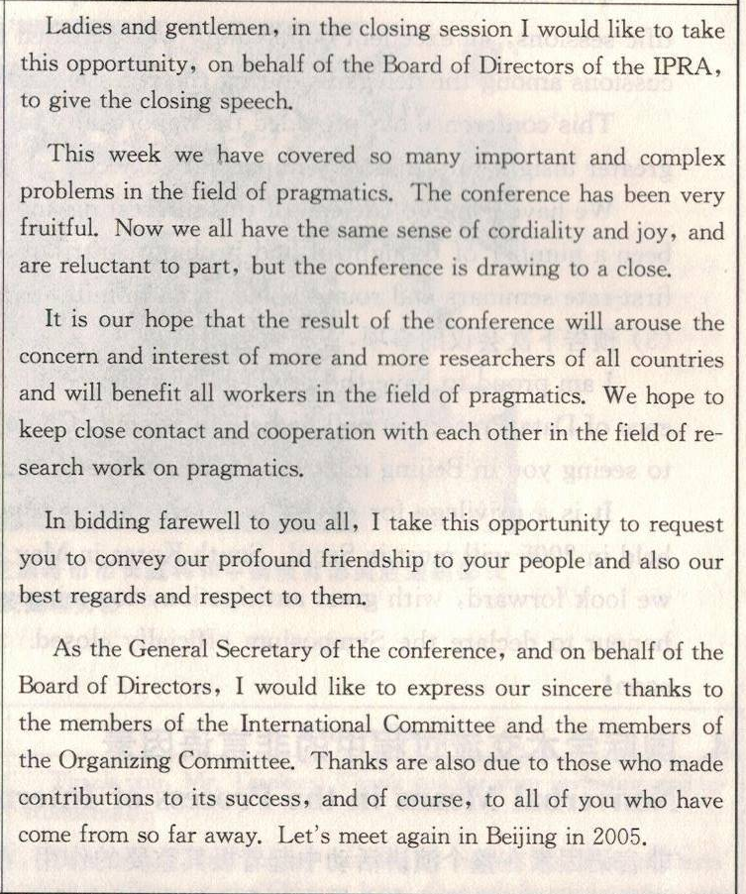
Practice
Work in small groups to discuss and figure out what are included in the closing speech on the left.
Purpose of the speech
Review and evaluation
significance and expectation
Best wishes
appreciation and invitation

Slide 21
References
1. 从丛，王文宇 《学术交流英语教程 （第二版）》 南京大学出版社 2014年
2. 吴斐，周频 《国际学术交流英语》 武汉大学出版社 2008年
3. 王慧莉，姜怡 《学术交流英语》 高等教育出版社 2006年
4. 刘晓丹，黄芙蓉 《学术交流》 哈尔滨工业大学出版社 2011年
5. Teaching materials (PPT) prepared previously by Professor刘健刚
6. Suggestions and materials offered by 盛雪梅 and 卢凤娟

Slide 22


